Slide 1
Category review: Chips
JULY 2025
Retail Analytics

Slide 2
Notes:
To view Privacy video explaining how important data privacy is to Quantium, please click here: https://www.youtube.com/watch?v=Zq1QDAkoRzU
or here Q:\Company Reference\Brand & Design\Brand videos\Q Privacy.mp4
At Quantium, we believe that data is the behavioural footprint of humanity and that it has to be treated with the utmost care and responsibility.
Histories, attitudes, indeed lives are stored within it in ways that aren’t always apparent – and that’s what makes its potential so powerful.
To work with it responsibly, sensitively, we set ourselves the highest data privacy protection and governance standards.
We have spent 17 years perfecting privacy-by-design and secure-by-design principles. Central to this is not holding any personally identifiable information about people –
we neither receive it, and put the necessary protections in place to be unable to decipher it.
Every aspect of handling data is safeguarded: from its de-identification, to its encryption – data security is paramount and of the highest grade.
We pride ourselves on gaining the trust of iconic organisations around the world through years of securely working with their data,
and in turn the trust that builds with their stakeholders.

Slide 3
Executive summary
01
1. Although there are more mainstream young singles and couples and retirees than older families, older families' sales exceed these demographics. Compared to other sectors, elderly households purchase more chips.
2. Compared to their budget and premium counterparts, modern young singles and couples as well as mid-aged singles and couples are willing to pay more per package.
3. There is a notable disparity between the average of mainstream and premium. The unit cost of a mainstream product is substantially greater than that of a luxury product.
4. Young singles and couples in the target segment most like Doritos and Kettle. Doritos are more well-liked by the target segment than by the nontarget group when compared to the mainstream and nonmainstream.
5. 175 is the most common pack size for both target and nontarget. 330 and 380 are more for the target group.
Data Preparation and Analytics for Customers
02
Trail Store
1.Because the trial store's performance falls outside of the control store's 5% to 95% confidence interval in two of the three trial months, the results indicate that the trial in stores 77 and 88 differs considerably from its control store during the trial period.
2. Before the trial period, sales at trial store 86 increased, but the number of customers stayed the same.

Slide 4
01
Data Preparation and Analytics for Customers

Slide 5
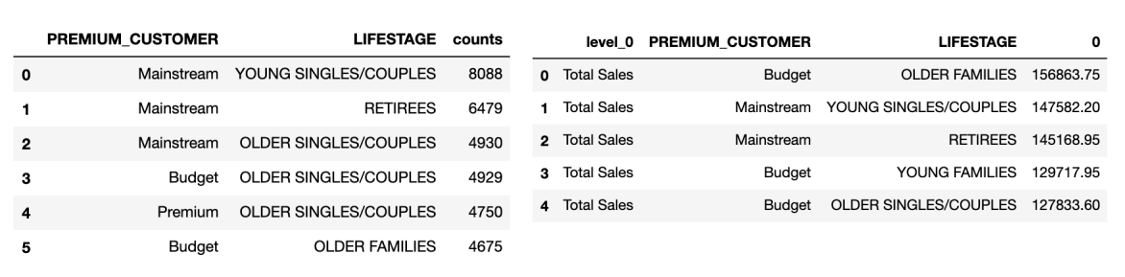
Number of Mainstream young singles/couples and retirees are more than older families, but the sales of older families are more than these segmentations. Each older families buy more chips than other segments.

Slide 6
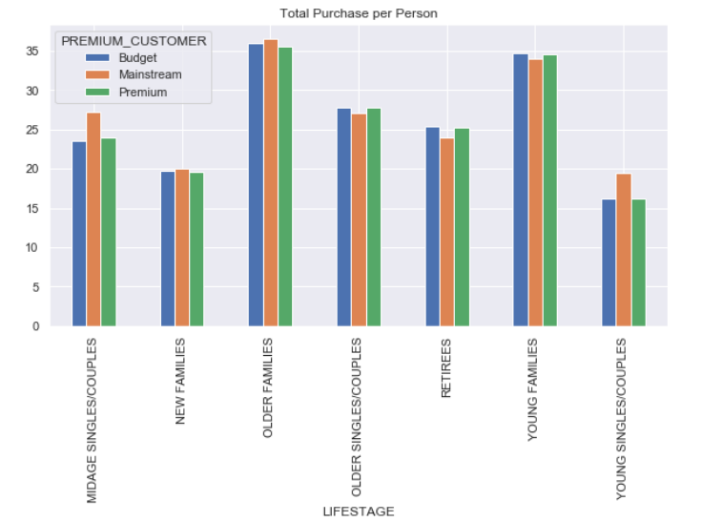
Maintream young singles/couples and midage singles/couples are willing to pay more per package comparing to thier budget and premium counterparts.

Slide 7
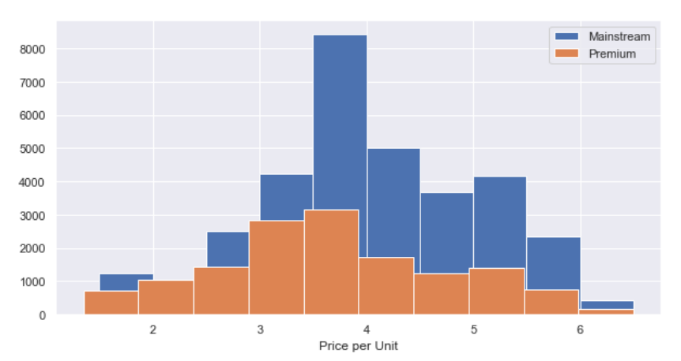
The difference between mean of mainstream and premium is significant. The mainstream product unit price is significantly higher than premium product.

Slide 8
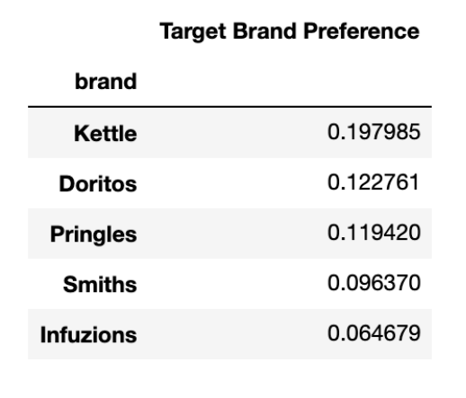
For target segment young singles/couples, they prefer Kettle and Doritos most. if comparing with mainstream and nonmainstream, Doritos is more popular among target segment than nontarget group.

Slide 9
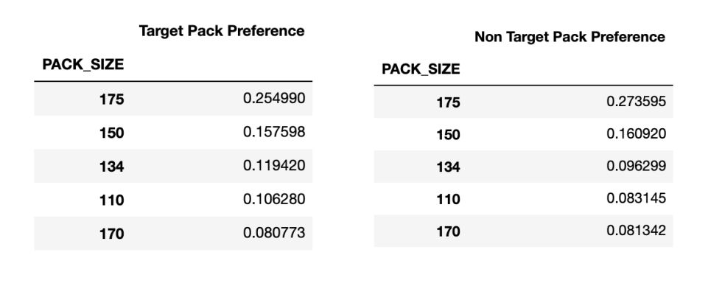
For both target and nontarget, the most popular pack size is 175. For target group, 330 and 380 are more popular than in nontarget group.

Slide 10
02
Trial store performance

Slide 11
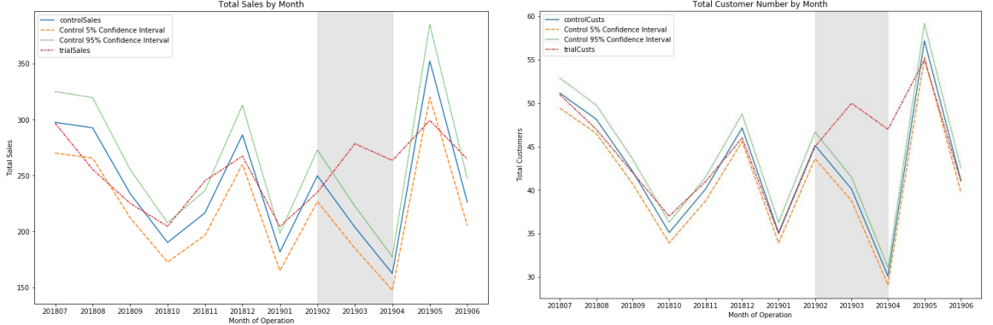
Trial Store 77, Control Store 233
Trial Store 77 in Red, Control Store 233 in Blue, the sales increases with customer quantity.

Slide 12
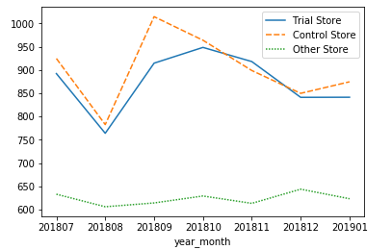
Trial Store Shows ~12% Uplift Post Layout Change (Oct–Dec 2018)
Trial Store sales rose from 770 (Aug 2018) to a peak of 950 (Oct 2018) post-layout change.
Control Store peaked at 1000 (Sep 2018) but dropped to 850 (Dec 2018).
Trial Store outperformed Control Store from Oct–Dec 2018, showing a ~12% uplift in Dec.
Other Store remained stable around 630–660, showing no significant trend.

